Slide 1


Banking System
Application
A Web-Based Application
Nihal Badiger | Sailesh G. | Pranav Kumar | Anshaj Gupta

Slide 2
Introduction to the Bank Management System Application
The Application is a secure, user-friendly web-based system that enables seamless peer-to-peer (P2P) payments and financial transactions.
Purpose
Simplify fund transfers and financial transactions for registered users. Provide users with the ability to send, receive, and track payments in a secure environment.
Target Audience
Individuals who require a reliable and straightforward system for transferring payments.
Small businesses or groups managing payments among limited users.
Features
Instant Payments: Users can transfer funds between accounts quickly and securely.
Account Management: Manage balances and view transaction history easily.
Transparency: Detailed logs of transactions with timestamps.
Data Export: Export transaction history for record-keeping.
Core Principles
Security: Password hashing, secure sessions, and data validation for safe usage.
Simplicity: Intuitive user interface to ensure ease of use for non-technical users.
Reliability: Ensures accurate balance management and secure fund transfers.

Slide 3

Key Features of the Application
The Application includes all essential features to manage financial transactions seamlessly, such as registration, secure login, fund transfers, and transaction tracking
Withdraw Funds
Peer-to-Peer
(P2P) Transfers
Deposit
Funds
Transaction
History
Account
Dashboard
Export
Transaction
Data
Each action is designed to be intuitive while ensuring a smooth experience for all users. The ability to export transaction history gives users flexibility to maintain financial records or analyze expenses efficiently
User
Registration
& Login
Secure Logout

Slide 4
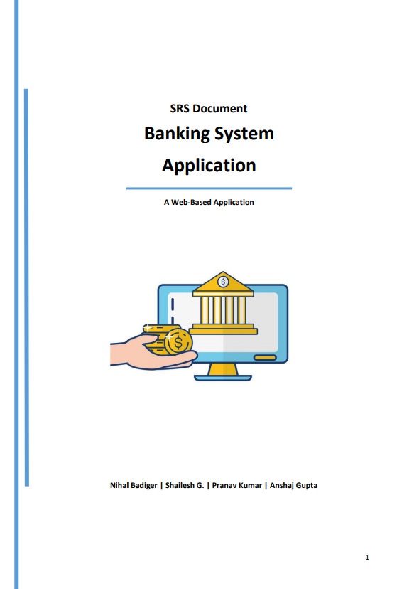
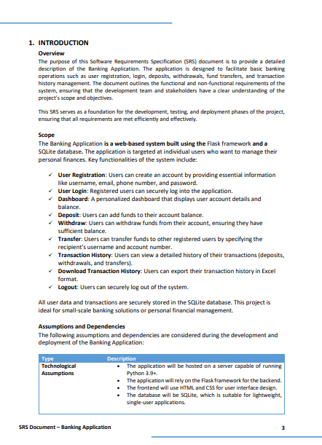
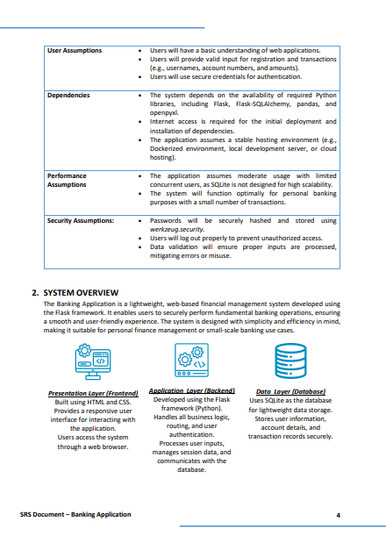
System Architecture
The SRS document will provide a detailed blueprint of the system, outlining its architecture, requirements, and future enhancements
It will discuss everything from functional requirements like registration and transfers to non-functional aspects like performance and security, ensuring a complete understanding of the application

Slide 5




Real-Life Use Cases for the Application
Splitting Bills Among Friends
Managing Small Group Finances
Small Businesses or Freelancers
Sending Money to Family or Friends
Scenario: A group of friends dines at a restaurant, and one person pays the bill.
How It Works:
The friends can quickly transfer their share to the payer using the application.
Real-time balance updates ensure transparency for everyone involved.
Benefit: Simplifies bill splitting without requiring cash or third-party apps.
Scenario: Clubs, associations, or housing societies need to manage shared expenses.
How It Works:
Users can contribute funds for shared expenses like maintenance or events.
The organizer can track contributions using the transaction history feature.
Benefit: Keeps financial records organized and accessible.
Scenario: A freelancer receives payments from clients for services rendered.
How It Works:
Clients can directly transfer funds to the freelancer’s account via the app.
Freelancers can download their transaction history for income tracking.
Benefit: Provides an easy-to-use solution for tracking client payments.
Scenario: Users want to quickly send money to family members or friends.
How It Works:
Users simply input the recipient's account details and transfer the desired amount.
Transactions are logged, ensuring transparency and accuracy.
Benefit: Offers a secure and quick alternative to traditional money transfers.

Slide 6
Thank-You

